Slide 1

BANKING APPLICATION-SMART BANK
Team Members:
Eadara Likhitha - 2626111
Golusu Prasanna - 2626202
Guvvala Sreeja Reddy -2625842

Slide 2

Agenda
Introduction
Objective
Testing
Technology
Stack
System Design
and
Architecture
Smart Bank
Authentication
Primary goals
Summary
Presentation Title

Slide 3

Introduction
Problem Statement: Traditional banking is time-consuming and often inconvenient. Customers want a secure, fast, and accessible banking from anywhere, anytime. Our solution: A smart banking app with features like self deposit, account transfer, secure withdrawals, and real-time balance monitoring.

Slide 4


*Modern Client-Server Architecture: Frontend: ReactJS for a responsive, intuitive user interface. Backend: Spring Boot REST API for business logic and security. Database: H2 for development (can be upgraded to MySQL/Postgres). Communication: Secure HTTP (with CORS enabled for cross-origin requests). *Key Features: 1.User authentication (login/signup with PIN) 2.Self deposit and transfer to other accounts 3.Withdrawals with PIN and transaction limits 4.Real-time balance and transaction history 5.Confirmation dialogs for all sensitive actions 6.Modern UI/UX with responsive design 7.Admin access to the page.
Application
ARCHITECTURE and
FEATURES

Slide 5
WORKFLOW
Phase | Tasks
Requirements | Define features, gather functional and non-functional requirements.
Design | Create system architecture, data models
Development (phase 1) | Set up Spring Boot project, basic login & account features
Development (phase 2) | Add deposit, withdraw, and transaction history, account balance check
Testing | Unit testing, integration testing
Documentation | Prepare documentation, polish code

Slide 6
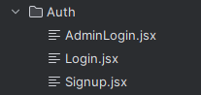
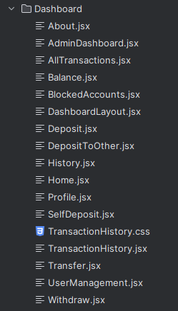
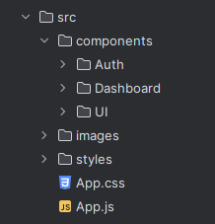
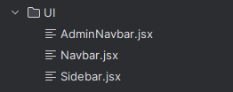
Frontend Structure

Slide 7
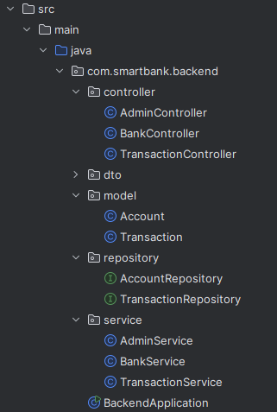
Backend Structure

Slide 8
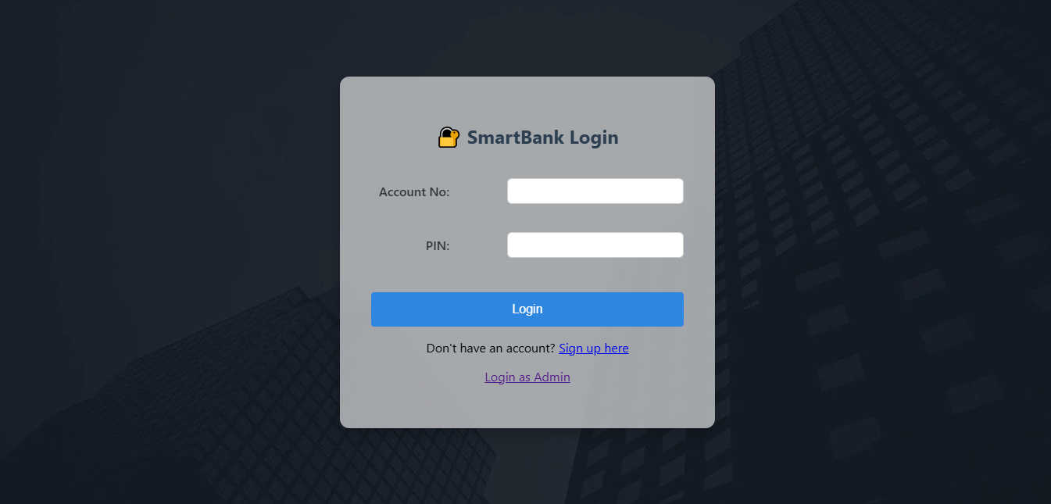
User Interface Showcase
secure login and signup with PIN-based authentication.
Prevents unauthorized access
Code reference: /login and /signup endpoints in backend, react login form.
Admin access is restricted to users

Slide 9
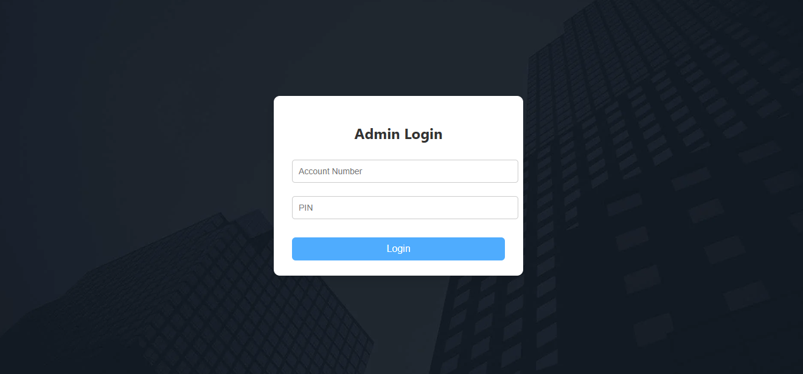
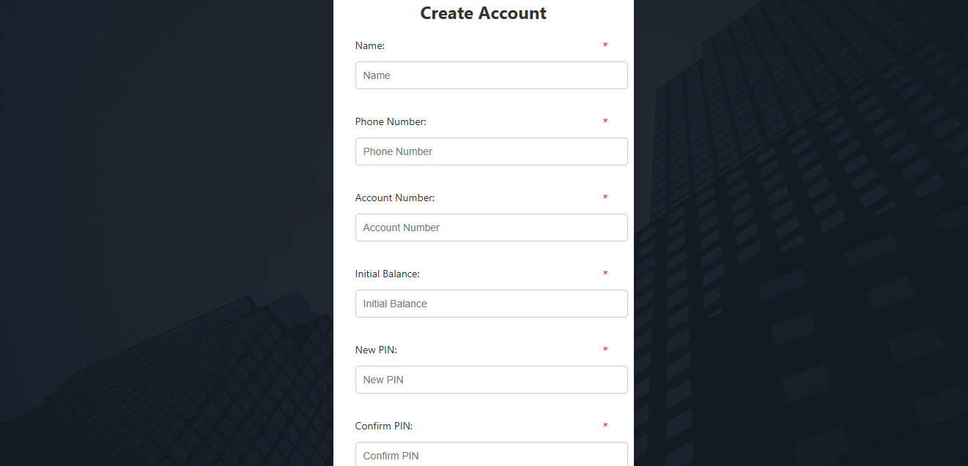

Slide 10
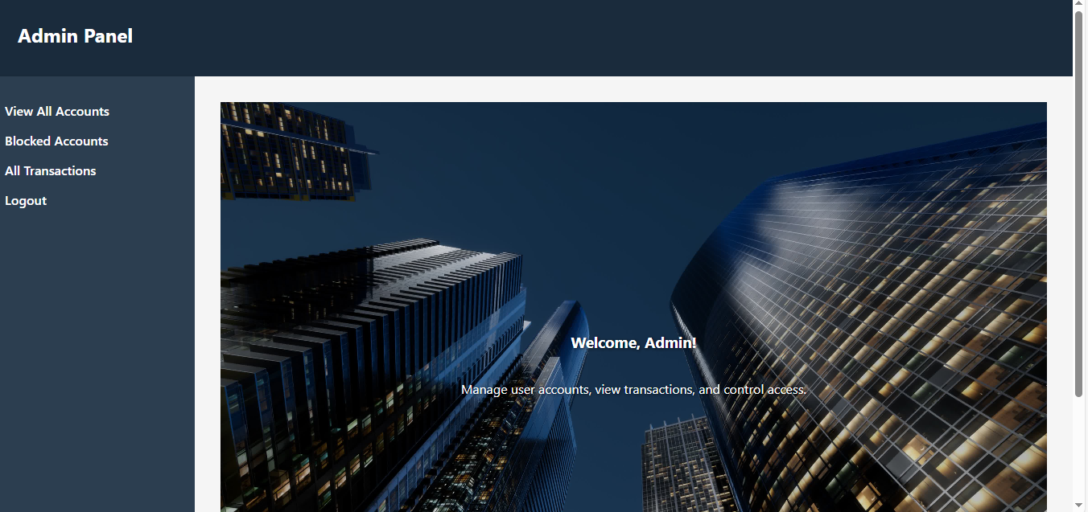
Admin Login Page
Centralized admin control panel
Quick access to accounts and transactions
Clean and user-friendly interface

Slide 11
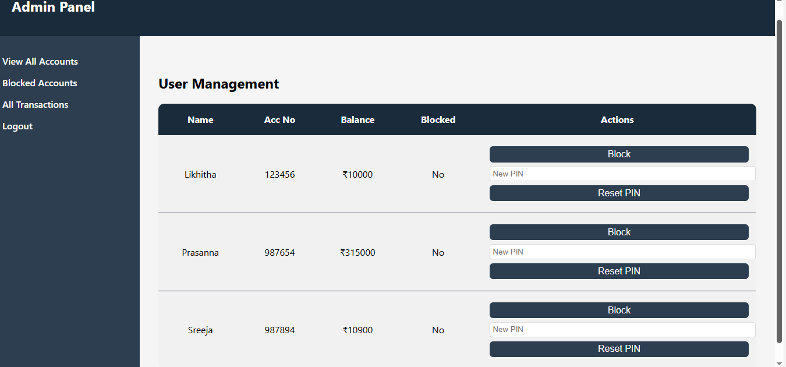
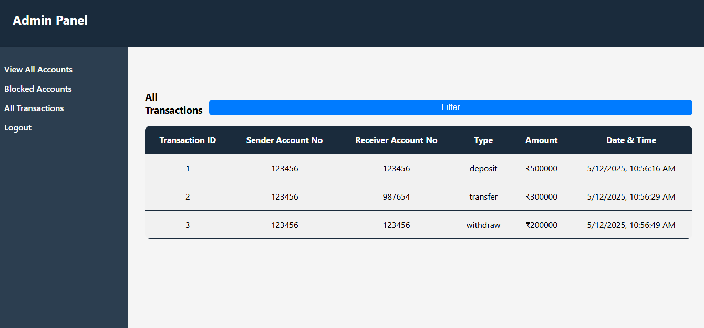
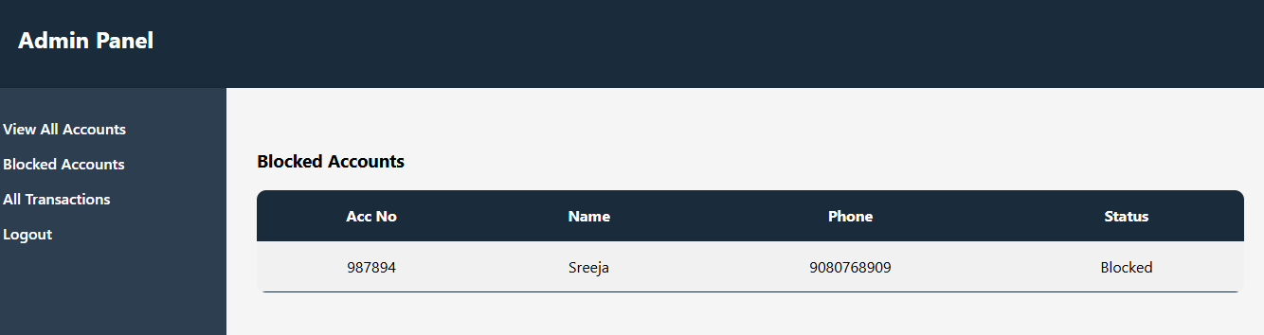
How are they displayed?

Slide 12
Deposit Functionalities
Self Deposit: Instantly add funds to your own account with a single tap.
Transfer: Send money securely to any other account.
Two green side-by-side buttons let users choose deposit type for clarity and speed.
Confirmation modal shows all transaction details before finalizing, reducing errors and increasing user trust.
Backend validates PIN, updates balances, and records every transaction for transparency and security.

Slide 13
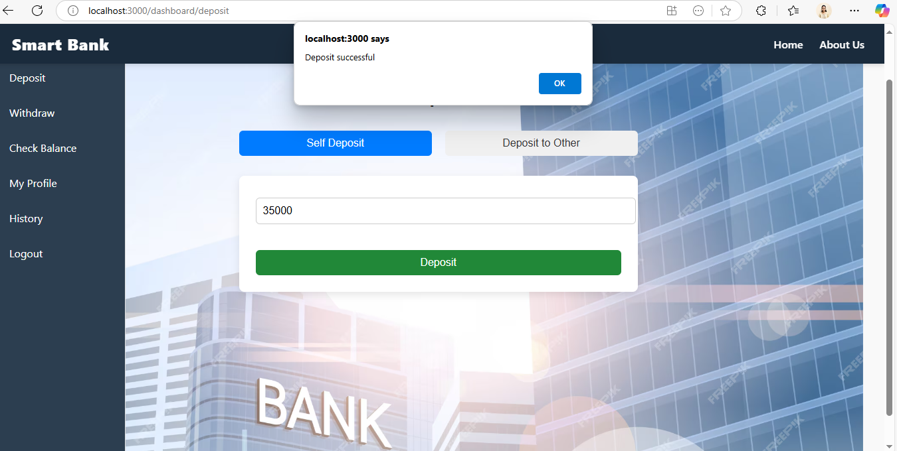
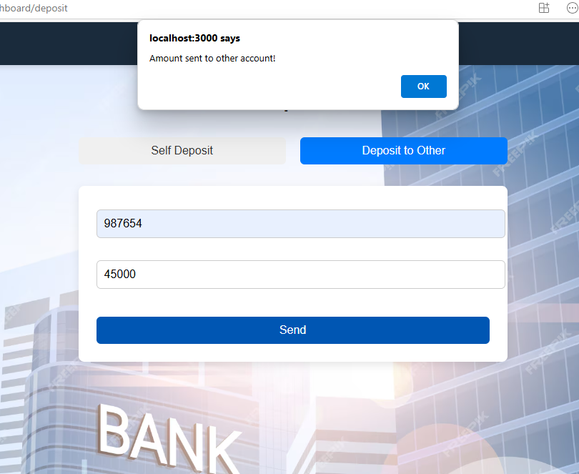
How are they displayed?

Slide 14
Withdraw Functionalities
Withdraw funds securely after PIN verification.
Real-time balance, daily/transaction limits, and transactions left are shown in a light green info box for user awareness.
Confirmation dialog prevents accidental withdrawals.
Success and error messages provide instant feedback.
Backend enforces all limits and records each withdrawal for auditability

Slide 15
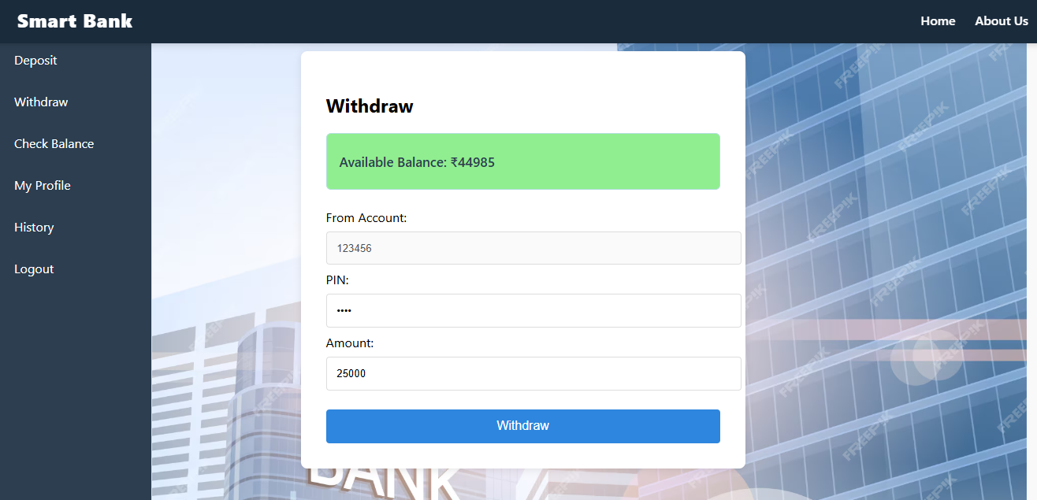
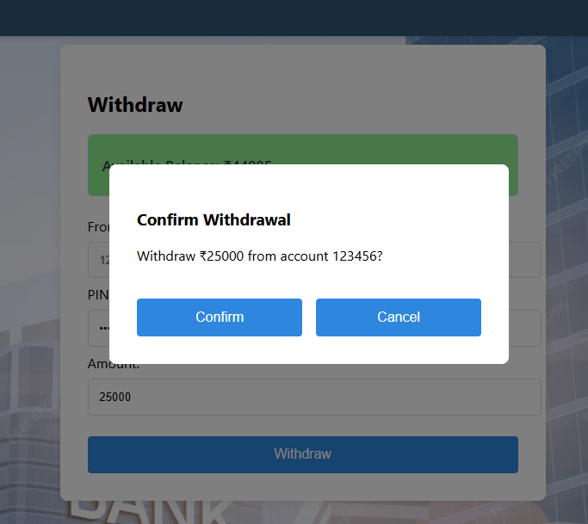
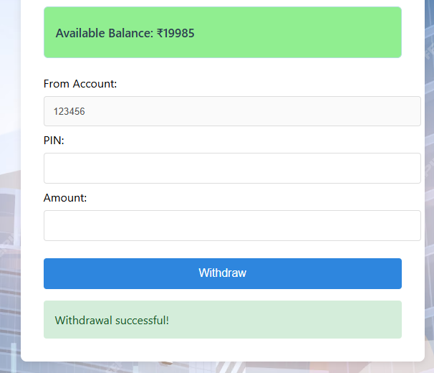
How are they displayed?

Slide 16
Check Balance
The Check Balance feature provides users with immediate visibility of their available funds right after login, meeting the core expectation of digital banking user
Users can toggle balance visibility (show/hide) for privacy in public settings, enhancing user trust and comfort
A quick snapshot of recent transactions is shown below the balance, helping users monitor activity and verify account changes without leaving the dashboard
he balance screen is only accessible after secure PIN authentication, and all sensitive data is handled securely, reinforcing user confidence in the app

Slide 17
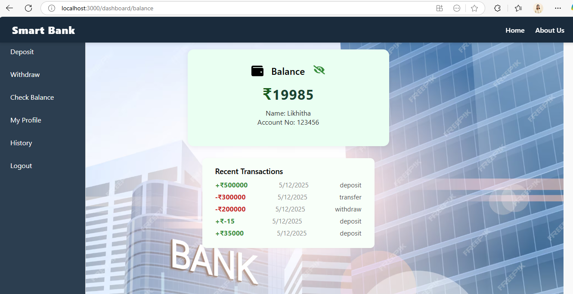
How are they displayed?

Slide 18
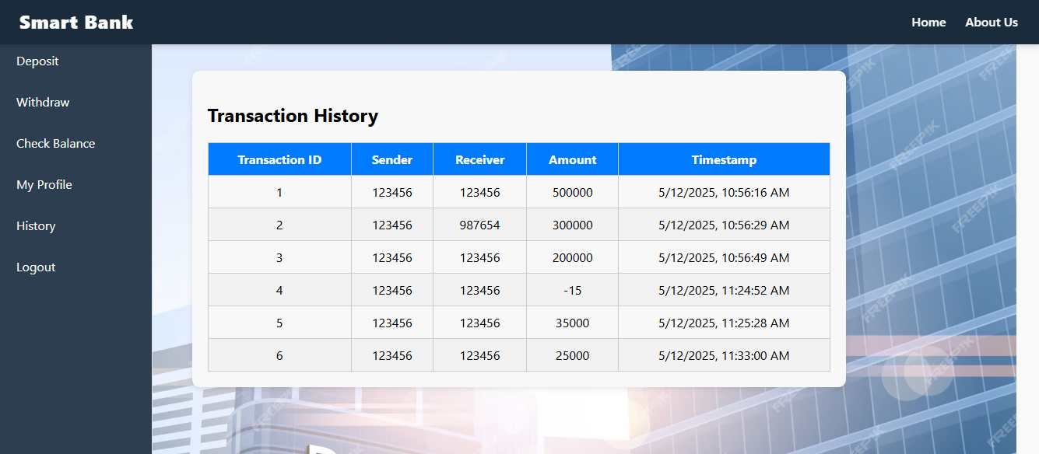
Transaction History
Organized list of all transactions
Filter and sort options for easy navigation
Transparent record for user verification
Backend: /transactions/{accNo} endpoint returns sorted transaction list.

Slide 19
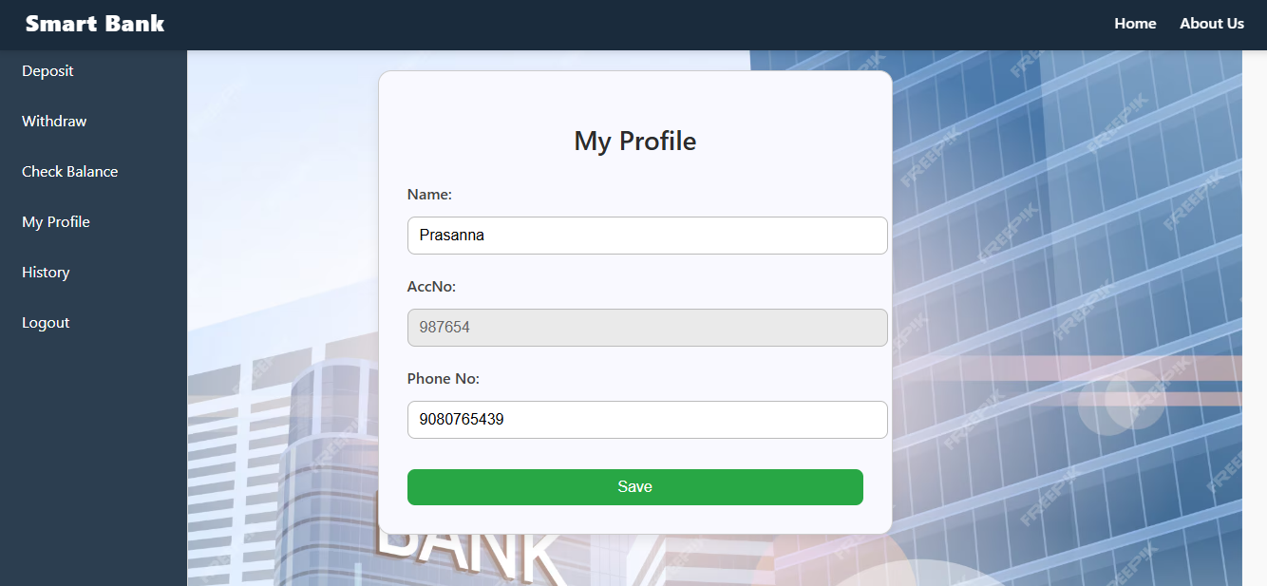
Profile view
Allow user to view and update their personal details.
Account number is shown but locked for editing to ensure security.
Simple interface with a save option for quick updates.

Slide 20


Conclusion
Our Smart Bank application delivers secure, modern, and user-friendly digital banking.
Key features include:
Secure PIN-based authentication
Self deposit and account-to-account transfer
Withdrawals with real-time limits and confirmation
Instant balance overview and transaction history
Responsive and accessible design
By combining robust backend logic with a clean, intuitive UI, we provide users with a trustworthy and efficient banking experience.

Slide 21




Thank you
Eadara Likhitha(2626111) - eadara.likhitha@mphasis.com
Golusu Prasanna(2626202) - golusu.prasanna@mphasis.com
Guvvala Sreeja(2625842) - guvvala.reddy@mphasis.com

